Slide 1
Fresnel Equations
A glimpse into what Fresnel Equations are and what we can learn from them

Slide 2
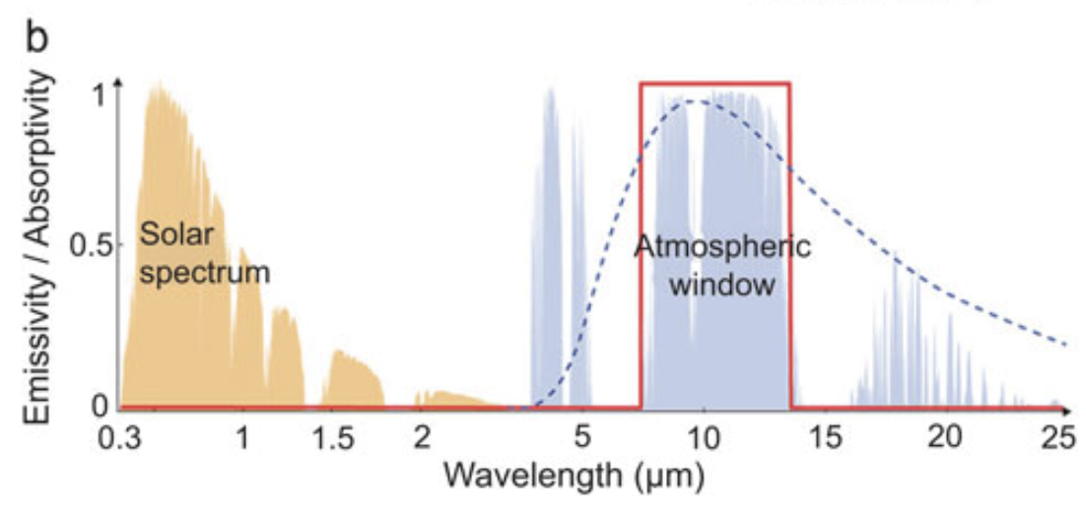

Motivation
One of the characteristics of a Passive Daytime Radiative Cooling (PDRC) device is that it needs to be highly reflective in the solar wavelengths.
As such, we need a way to quantifiably determine how much light is reflected off of a PDRC’s surface, how much is transmitted through, and how much is absorbed according to

Slide 3
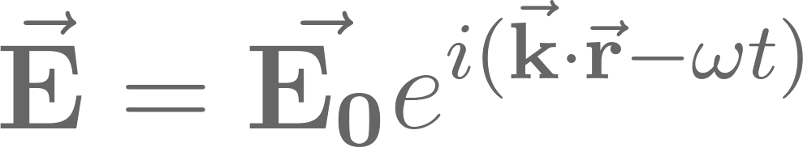
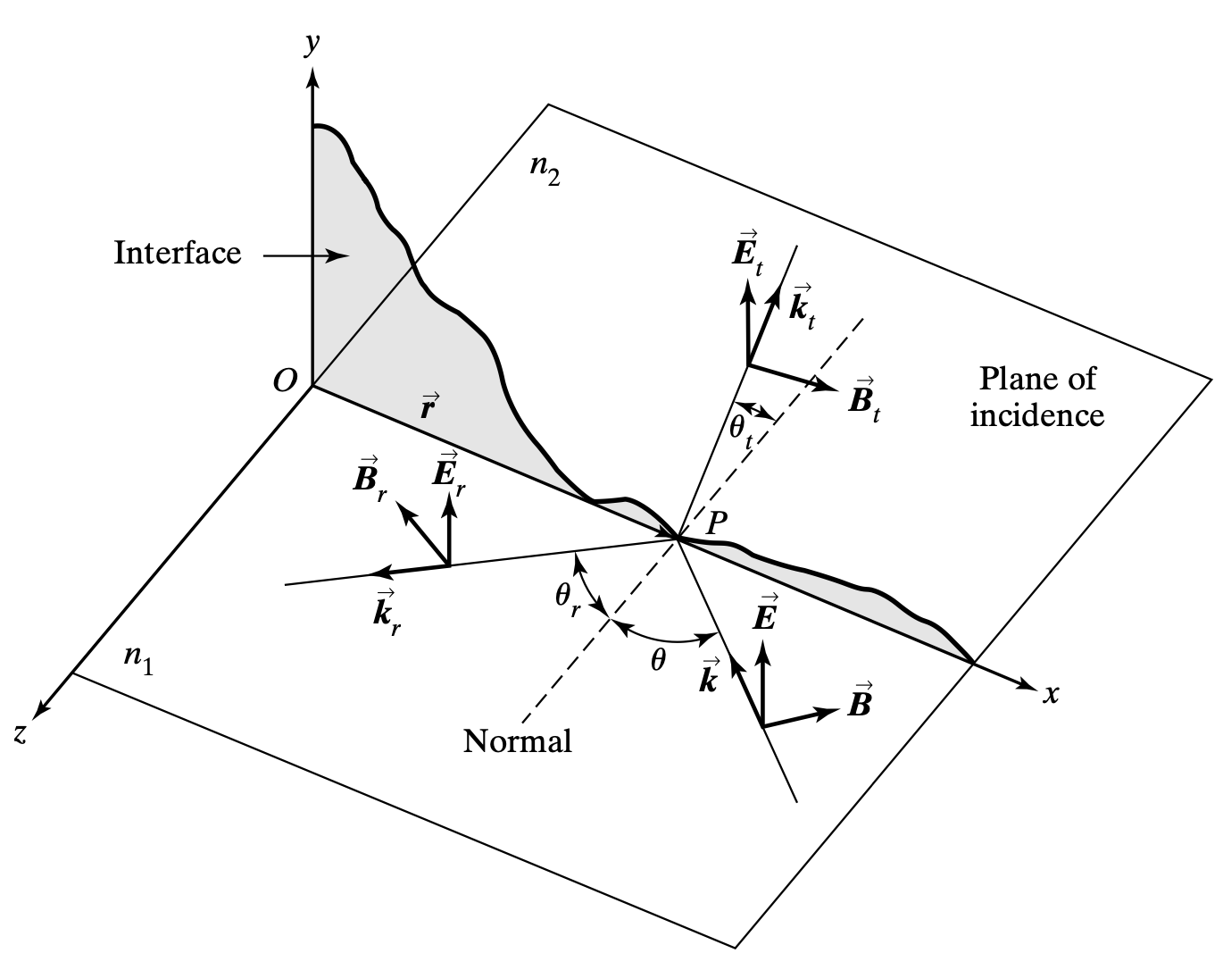
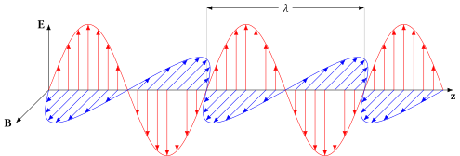
Set-UP
We are going to assume the incident light consists of harmonic wave expressed by:

Slide 4
Set-UP
Depending on the polarization of light as it hits the interface, we can form 2 categories of polarization:
Transverse Electric (TE) mode where the electric field is perpendicular to the plane of incidence.
Transverse Magnetic (TM) mode where the magnetic field is transverse to the plane of incidence.

Slide 5
Boundary conditions for te waves
We can write the vector amplitudes of the electric fields for the incident, reflected, and transmitted components as:
The associated magnetic fields are:
Notes:
Boundary conditions are derived from Maxwell's equations and ensure that the behavior of electromagnetic fields (electric and magnetic) remains consistent on both sides of the boundary.
Conservation principles dictate that the total amount of electric charge and energy remains constant, even as the wave interacts with the interface.
Continuity of the electric field parallel to the interface: This ensures that the electric field component parallel to the boundary is continuous, preventing abrupt changes in the field.
Continuity of the magnetic field parallel to the interface: Similarly, the magnetic field component parallel to the boundary is required to be continuous to maintain the integrity of magnetic field lines.

Slide 6
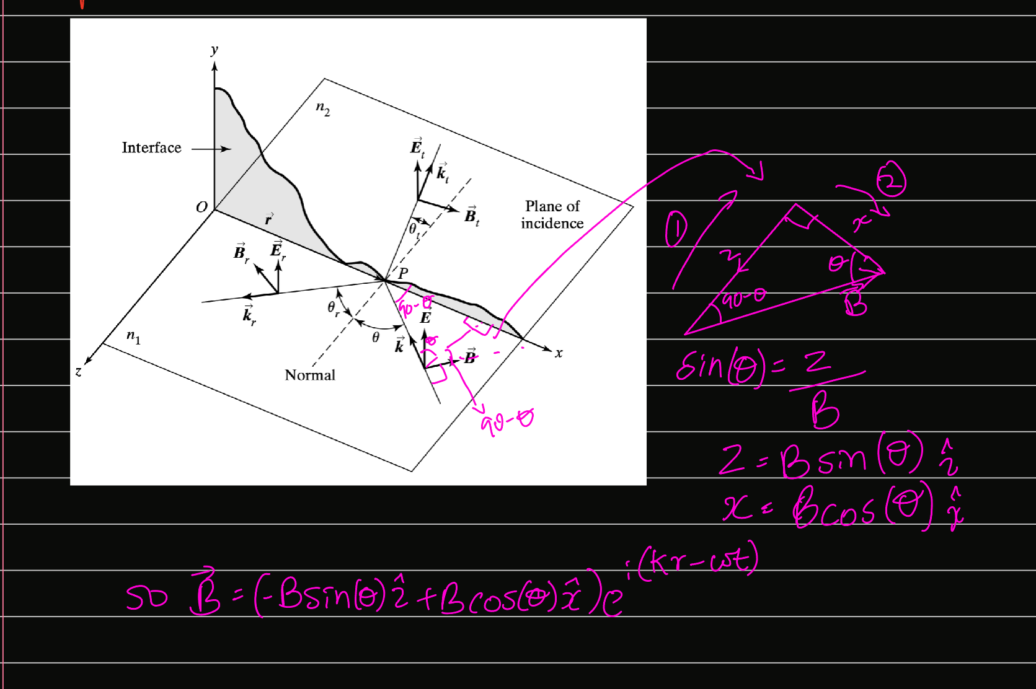
An example of how we arrive at the TE magnetic field equations

Slide 7

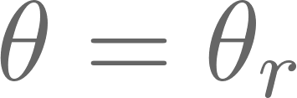
Boundary conditions for te waves
Continuity at the interface requires that:
Where according to the law of reflection.

Slide 8
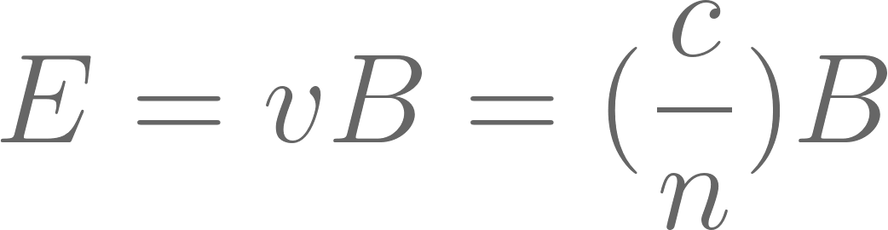
REFLECTION AND TRANSMISSION COEFFICIENTS (for te).
The magnetic field amplitude can be expressed in terms of
But we know:
and
in terms of E (recall that for both the incident and reflective case, the refractive index is n_1) .
Using
we can express
Finally, we have 2 important equations for our TE case:

Slide 9
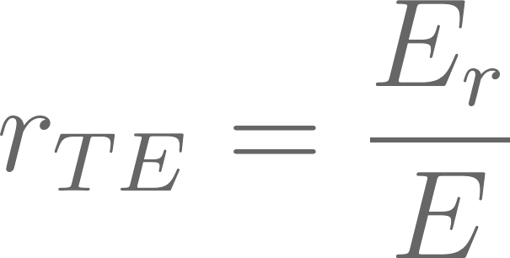
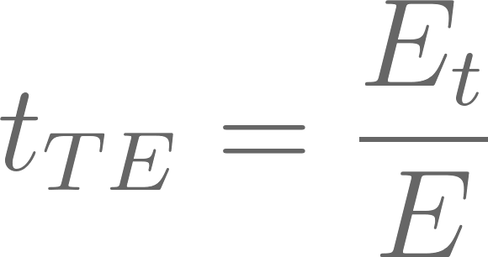
REFLECTION AND TRANSMISSION COEFFICIENTS (for te).
By definition, the reflection and transmission coefficients are:

Slide 10

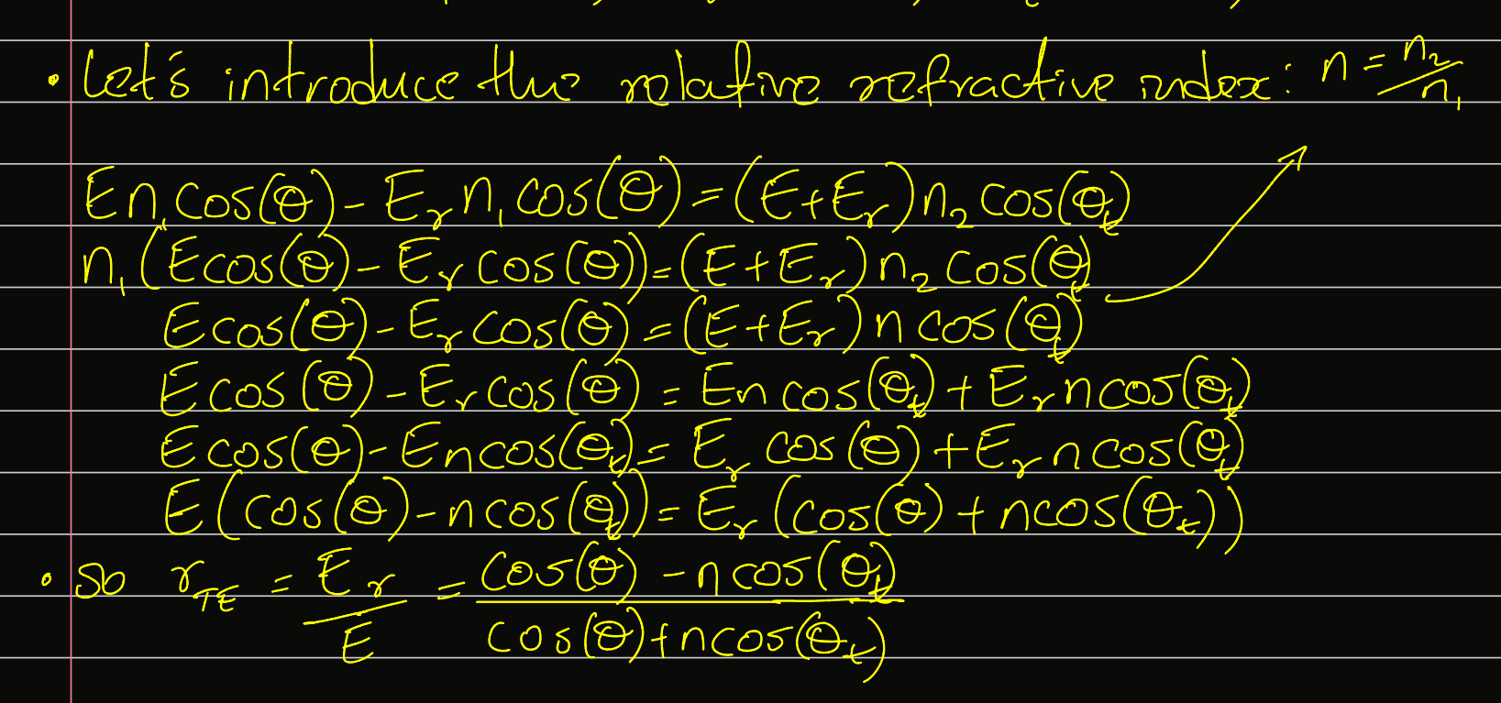
FIGURING OUT
Eliminate every mention of E_t.

Slide 11
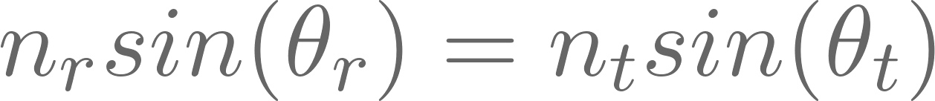

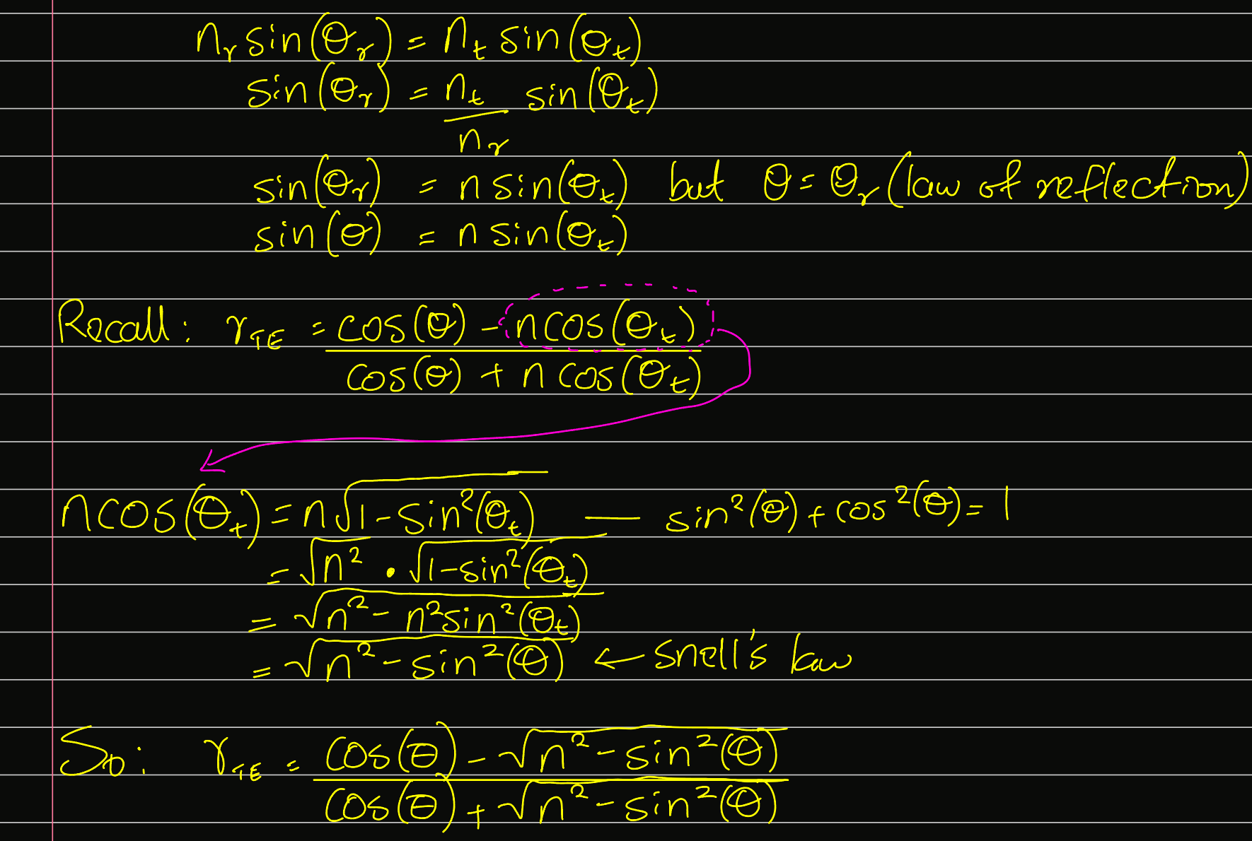
FIGURING OUT
The law of refraction states that:
We can use it to simplify our , since:

Slide 12

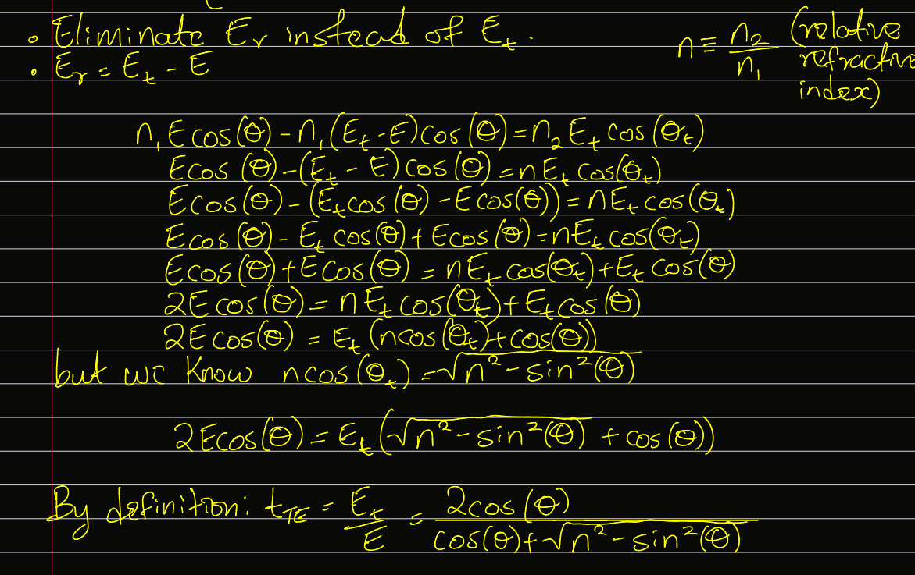
FIGURING OUT

Slide 13
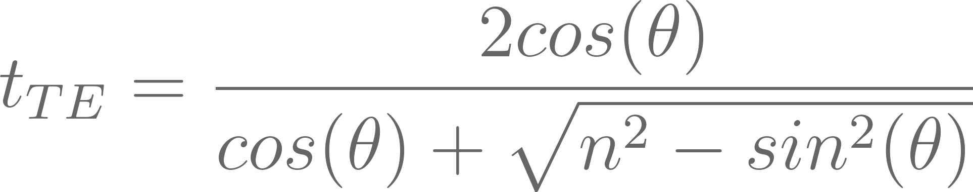
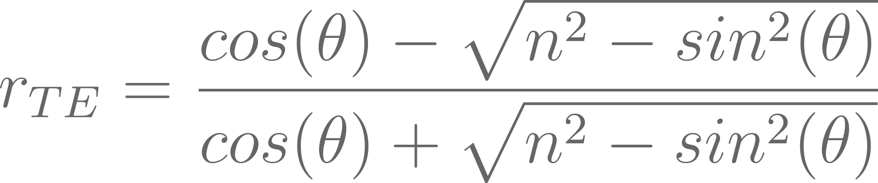
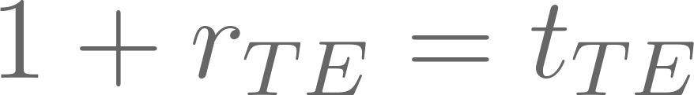
JOINING THE COEFFICIENTS TOGETHER.
Let’s look at what we have so far:
Let’s gaze at both of these equations. Can you note any similarities between them?
We can express both in terms of each other to get
Note: t_TE and r_TE are only one-half of the Fresnel equations.

Slide 14
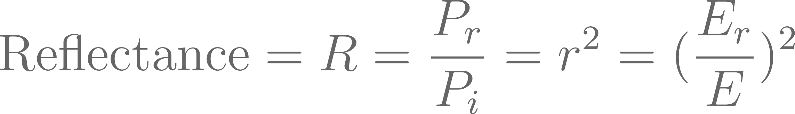
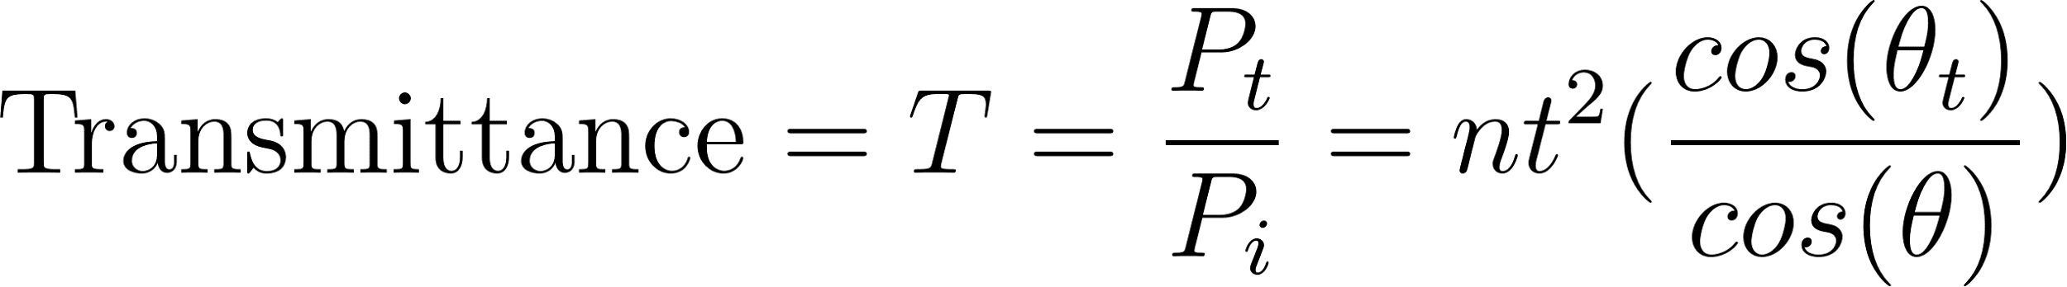
FINALLY, THE REFLECTANCE AND TRANSMITTANCE.
From the conservation of energy, trust me.

Slide 15


VISUALIZations
External reflection (think air-to-glass) occurs when
Internal reflection (think glass-to-air) occurs when

Slide 16
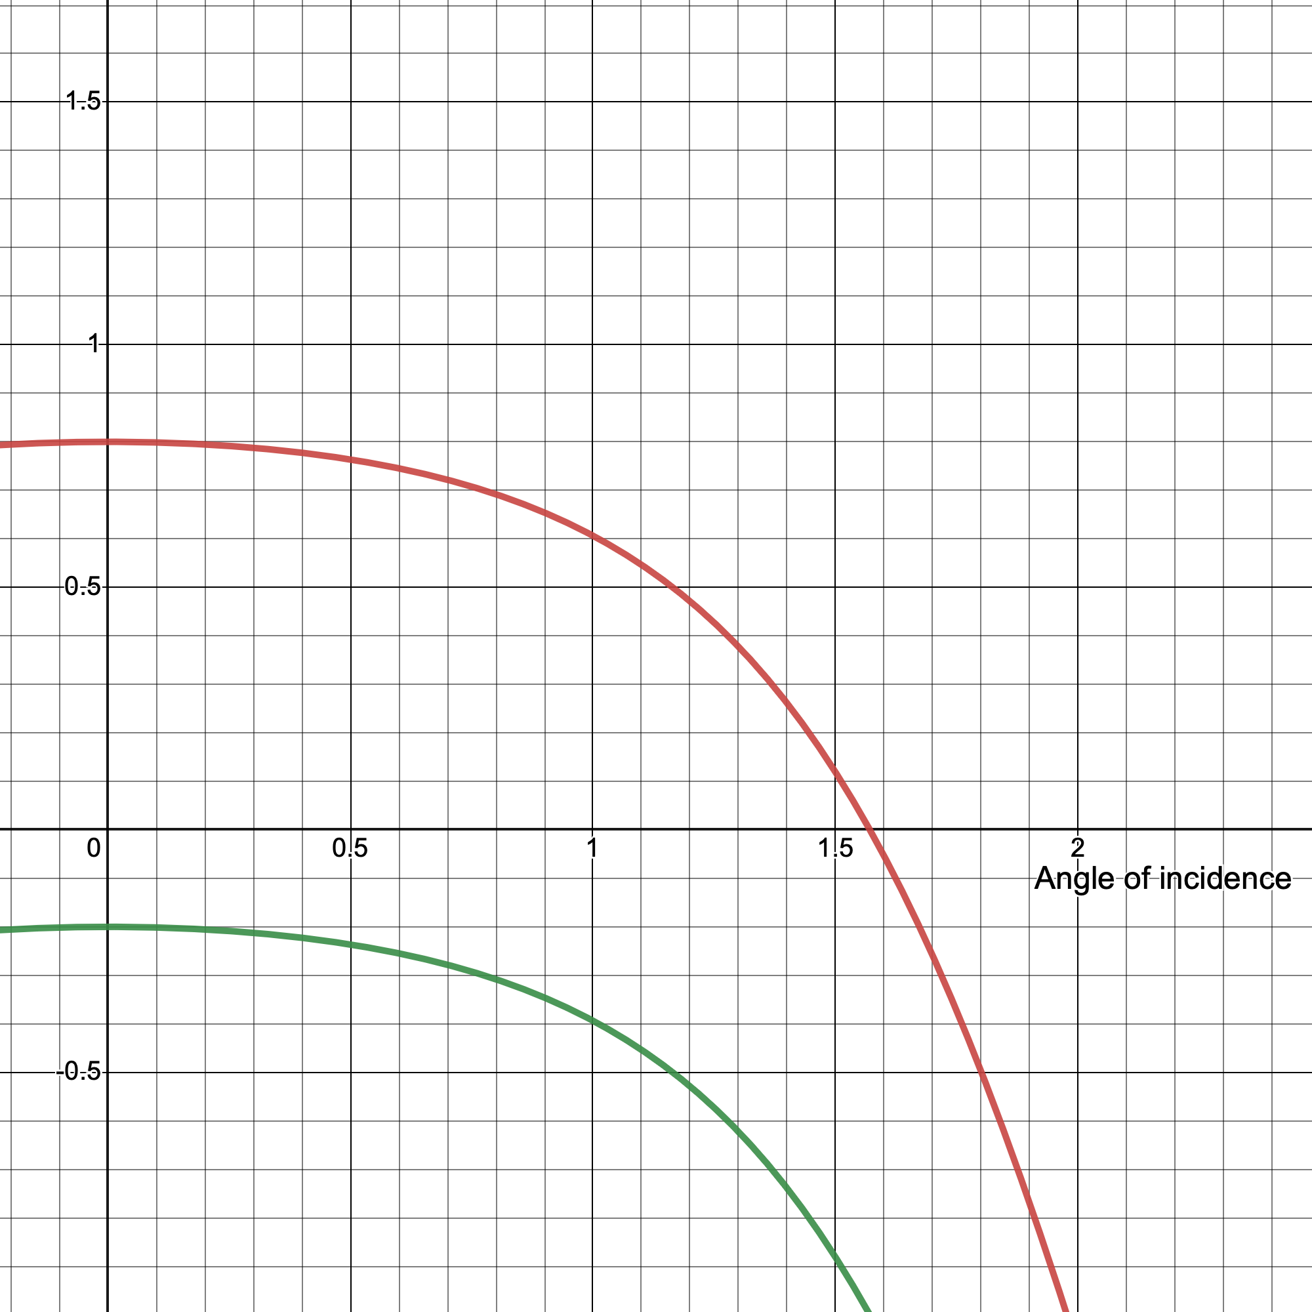
VISUALIZations
Red = t_TE
Green = r_TE
For normal incidence (when the angle of incidence is zero) {external reflection}

Slide 17
How do we make sense of the negative reflection coefficient?
Red = t_TE
Blue = r_TE
For normal incidence (when the angle of incidence is zero) {external reflection}
Recall also that:

Slide 18
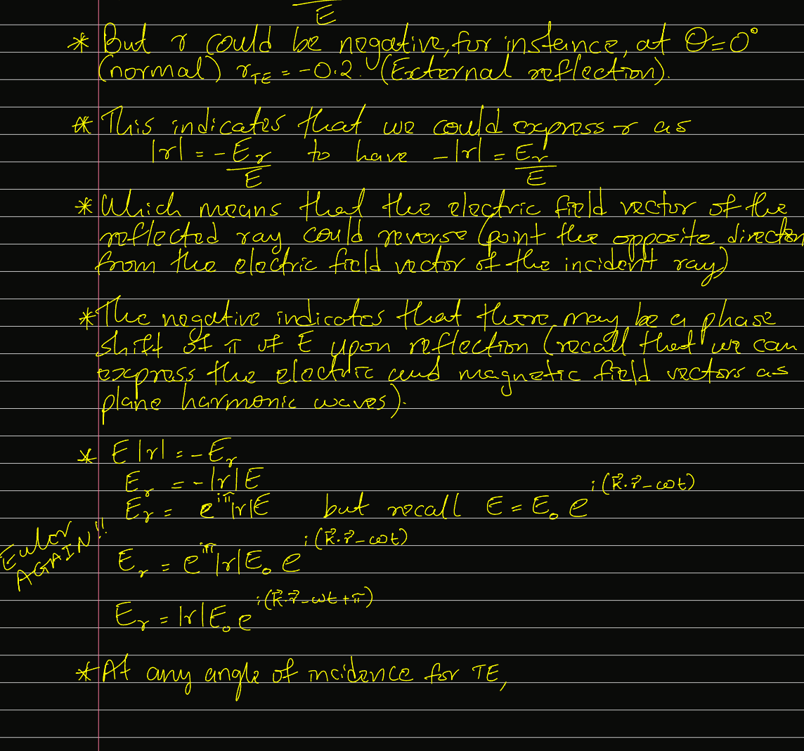

Slide 19
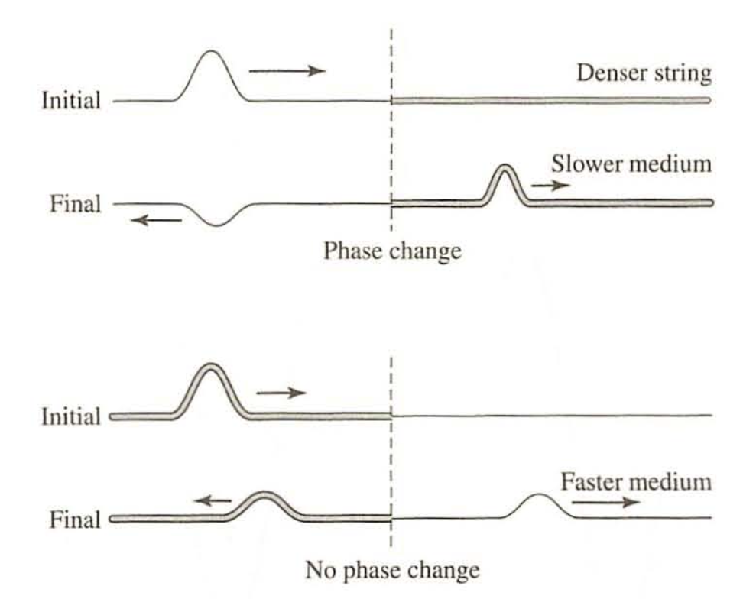
Phase changes
The reflected wave undergoes a phase change of 180 degrees when the reflection occurs at a junction where the transmitted wave slows down. When the transmitted wave speeds up at the junction, there is no phase change upon reflection.

Slide 20
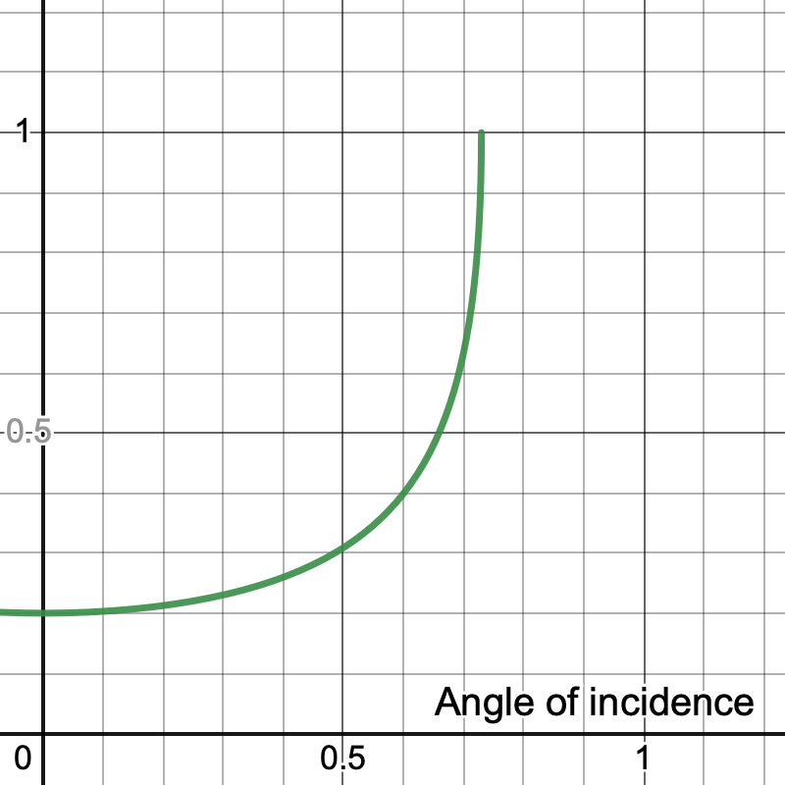
VISUALIZations
Internal reflection (glass-to-air). Note that r_TE reaches a maximum at 0.73 radians which is the critical angle at which total internal reflection occurs.
Total internal reflection is the phenomenon in which waves arriving at the interface (boundary) from one medium to another are not refracted into the second medium, but completely reflected back into the first medium.

